Slide 1
Election Result Prediction Using Twitter Data
B Sri Kanishka Reddy (1602-19-737-111)
A Krishna Chaitanya (1602-19-737-308)

Slide 2
Abstract :
Predicting election results is a hot area in political science. In the last decade, social media has been widely used in political elections. Most approaches can predict the result of a national election. However, it is still challenging to predict the overall results of many local elections.
This paper presents a machine learning based strategy to analyze Twitter data for predicting the overall results of many local elections.
The results suggest the predicted results are close to the actual election outcome. Researchers have used different approaches to investigate data from Twitter. These approaches focused on two issues. One is how to select Twitter messages. The other is how to analyze selected Twitter messages.
Few researchers selected Twitter message by using names of politicians involved in the elections. Their method used a sentiment score by counting positive and negative messages, which contains positive and negative words, respectively. If a message has both positive and negative words, it is both positive and negative. Others used keywords based on names of candidates to search related Twitter messages. They applied a Naïve Bayes model for sentiment analysis.

Slide 3
Precise Problem Statement:
The problem is to develop a model that can accurately predict the outcome of an election using Twitter data. Specifically, the model should be able to analyze tweets related to the election, including those containing candidate names, party affiliations, and key election issues, and make predictions about which candidate or party is likely to win. The model should take into account the sentiment of the tweets, the influence of the users who posted them, and other relevant factors that may affect the election outcome. The goal is to create a reliable and accurate election prediction tool that can help political analysts, journalists, and voters understand and anticipate the results of an election.

Slide 4
Literature Survey :
“A Survey on Election Outcome Prediction using Social Media Analysis" by Mustafizur Rahman et al. (2019): This survey paper provides an overview of recent research on election prediction using social media data. The authors reviewed 39 papers on the topic and identified key techniques and challenges in the field.
"Twitter Sentiment Analysis for Election Prediction in India" by Singh et al. (2017): This paper investigated the use of Twitter sentiment analysis for predicting the outcome of the 2014 Indian general election. The authors found that their model achieved an accuracy of 86% in predicting the election outcome.
Overall, these studies demonstrate the potential of Twitter data for predicting election outcomes, although there are still challenges and limitations to be addressed, such as the representativeness of the sample, the accuracy of sentiment analysis, and the influence of fake news and bots on social media.

Slide 5
Proposed Solution/Model Description:
Data collection: Collect tweets related to the election, including those containing candidate names, party affiliations, key election issues, and relevant hashtags. The data can be obtained using the Twitter API or other data mining tools.
Data preprocessing: Clean and preprocess the data by removing duplicates, irrelevant tweets, and noisy data. Apply text processing techniques such as tokenization, stemming, and stop-word removal to prepare the data for analysis.
Sentiment analysis: Use sentiment analysis techniques such as lexicon-based approaches, machine learning algorithms, or deep learning models to determine the sentiment of each tweet. Sentiment analysis can help identify the overall public opinion about the candidates and parties, and how it changes over time.
Feature extraction: Extract relevant features from the tweets, such as the number of tweets mentioning each candidate or party, the sentiment score of each tweet, the user's location, and the retweet count. These features can be used to build a predictive model for election outcome.

Slide 6
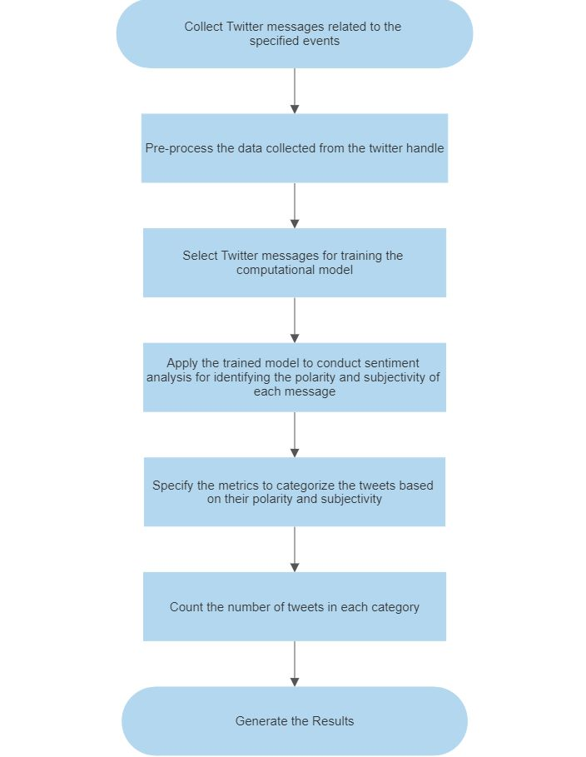
Block Diagram/Algorithm Flowchart:

Slide 7
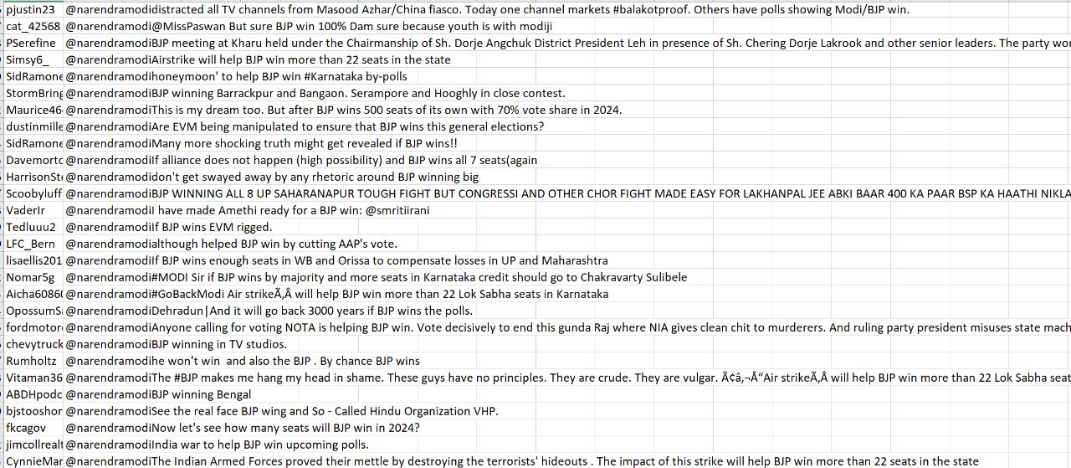
BJP Dataset :

Slide 8
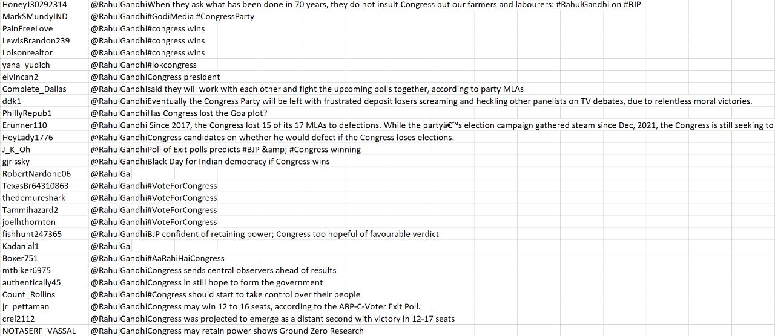
Congress Dataset :

Slide 9
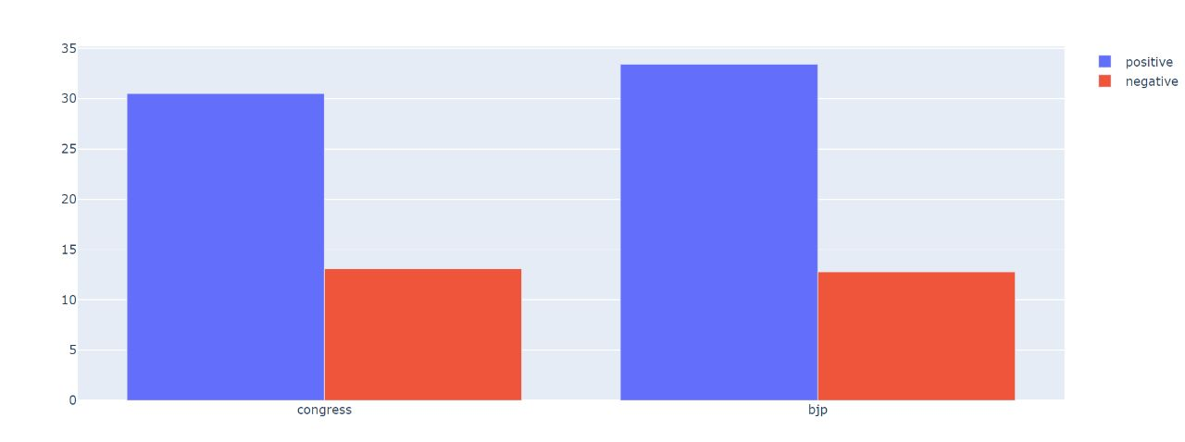
Evaluation Metrics :

Slide 10
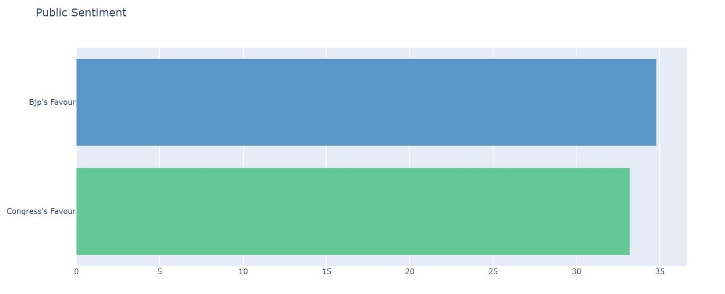
Results :

Slide 11
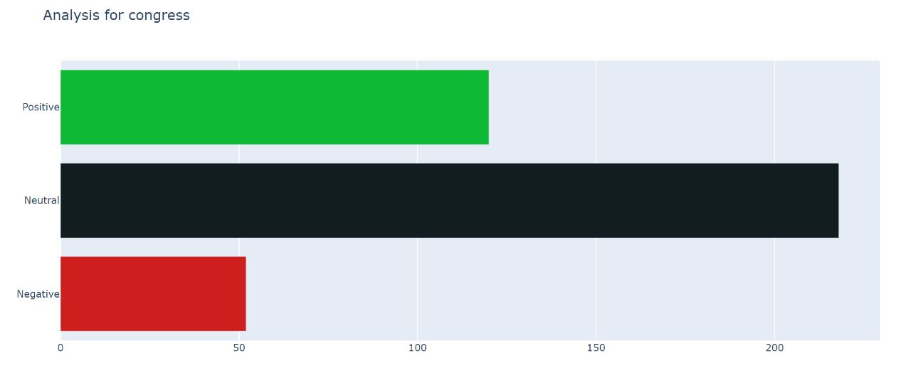
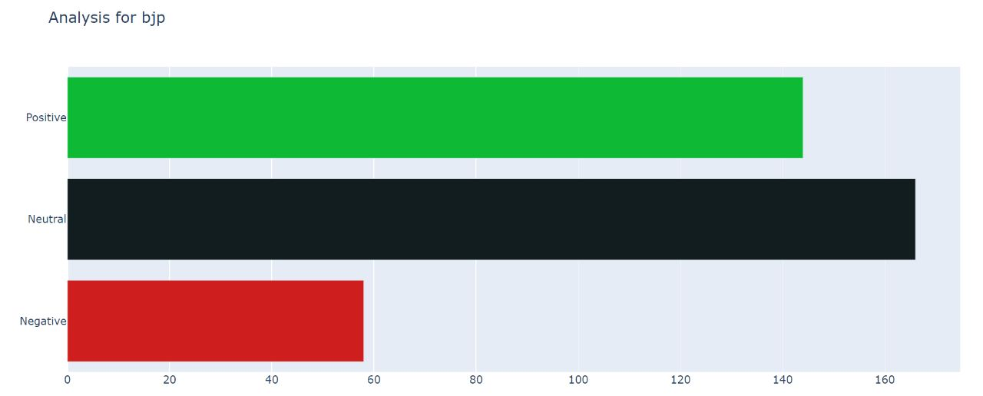
Analysis:

Slide 12
Conclusion and Future Scope:
Overall, election result prediction using Twitter data has the potential to revolutionize the way we monitor and understand election outcomes. As social media platforms continue to play an increasingly important role in shaping public opinion and political discourse, the need for accurate and reliable election prediction tools will only continue to grow.
Future research in this area can focus on several directions. First, the development of more sophisticated machine learning algorithms and deep learning models can help improve the accuracy and robustness of election prediction models and also inclusion of spam detection algorithms for erasing the irrelevant data.

